Slide 1

Course Name
COMPILER DESIGN
Course code
SCSA1604

Slide 2
Course Objective:
To explore the principles, algorithms, and data structures involved in the design and construction of compilers.
To introduce the theory and tools that can be employed in order to perform syntax-directed translation of a high-level programming language into an executable code.
Prerequisite Courses:
Theory of Computation
Data Structures
Programming Languages

Slide 3
UNIT 1 LEXICAL ANALYSIS
Structure of compiler
Functions and Roles of lexical phase
Input buffering
Representation of tokens using regular expression
Properties of regular expression
Finite Automata
Regular Expression to Finite Automata
NFA to Minimized DFA.

Slide 4








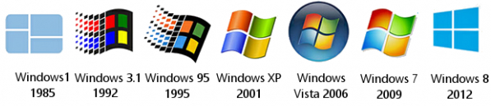
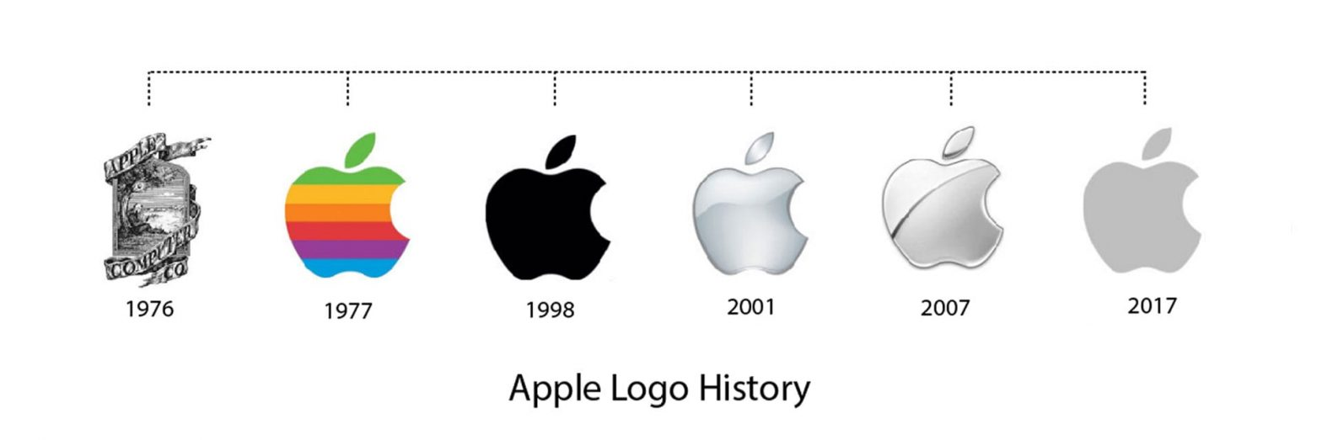







Application Software:
System Software:
Hardware:
User
Application
Software
System
Software
Hard
ware

Slide 5

Designed to control and coordinate the procedures and functions of computer hardware.
Enable functional interaction between hardware, software and the user.
System Software
Types
Operating system
Acts as interface between hardware, system programs
and user - windows
Device Driver
Device communication between OS and other programs – in-built drivers installed.
Firmware
Operational software embedded within memory chips – BIOS, UFEI – resides within devices
Translators
Intermediate programs to translate high level source code to machine language code
Utility software
Acts as interface between system and application software – maintenance tasks - Firewall

Slide 6
USER
Collection of programs
that bridges the gap
between the computer
and the user.
Basic examples:
Utility software
System servers
Device drivers
Operating system
Windows / Graphical
user interface system
Translates the needs of
The user in a language
that computer understands.
SYSTEM SOFTWARE
Acts as an intermediary
between the user
and the machine.
COMPUTER
Software designed to
provide platform for
other software's.

Slide 7
Languages
Low Level language is machine friendly. Commands or functions in the language map closely to processor instructions.
Assembly language is machine dependent ,the mnemonics that are being used to represent instructions are not directly understandable by machine.
High Level language is machine independent.
A computer understands instructions in machine code, i.e. in the form of 0s and 1s. It is a tedious task to write a computer program directly in machine code.
The programs are written mostly in high level languages like Java, C++, Python etc. and are called source code.

Slide 8
Language Processor
Source code cannot be executed directly by the computer and must be converted into machine language to be executed.
Hence, special translator system software is used to translate the program written in high-level language into machine code is called Language Processor and the program after translated into machine code (object program / object code).
There are three types of translator programs:
Assembler
Interpreter
Compiler

Slide 9
Assembler
Translate the program written in Assembly language into machine code.

Slide 10
Compiler
Reads the source program written in High Level Language(HLL) as a whole in one go and translates it into an equivalent machine language program.
Example HLL: C, C++, C#, Java…
The compiler specifies the errors at the end of compilation with line numbers.
The errors must be removed before the compiler can successfully recompile the source code again.

Slide 11
Interpreter
The translation of single statement of source program into machine code and executes it immediately before moving on to the next line is called an interpreter.
If there is an error in the statement, the interpreter terminates its translating process at that statement and displays an error message.
The interpreter moves on to the next line for execution only after removal of the error.
An Interpreter directly executes instructions written in a programming or scripting language without previously converting them to an object code or machine code. Example: Perl, Python and Matlab.

Slide 12
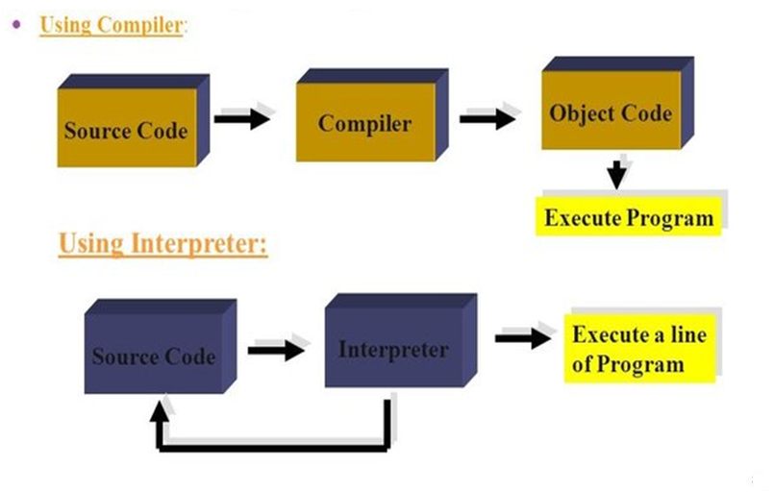
What is the difference?
Once a program is compiled, its source code is not useful for running the code.
For interpreted programs, the source code is needed to run the program every time.

Slide 13
Compiler vs Interpreter
COMPILER | INTERPRETER
A compiler is a program which coverts the entire source code of a programming language into executable machine code for a CPU. | Interpreter takes a source program and runs it line by line, translating each line as it comes to it.
Compiler takes large amount of time to analyze the entire source code but the overall execution time of the program is comparatively faster. | Interpreter takes less amount of time to analyze the source code but the overall execution time of the program is slower.
Compiler generates the error message only after scanning the whole program, so debugging is hard as the error can be present any where in the program. | Its Debugging is easier as it continues translating the program until the error is met.
Generates intermediate object code. | No intermediate object code is generated.
Examples: C, C++, Java | Examples: Python, Perl, JavaScript

Slide 14
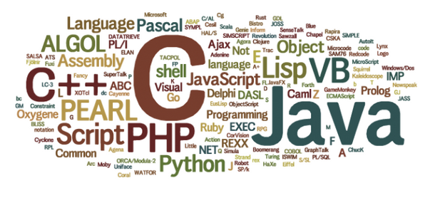
Languages that use compilers; Pascal, C ++, Ada, Visual Basic, C and many more.
Languages that use interpreters; Python,HTML, XML, PHP, Script Languages.

Slide 15
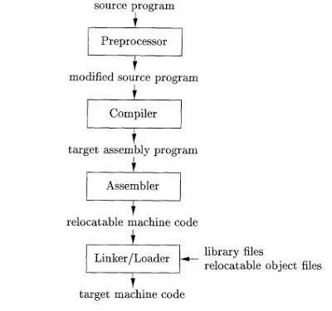
Language Processing System

Slide 16
Language Processing System
Preprocessor:
It replaces macros with their definitions, discovers dependencies and resolves preprocessor directives.
Linker:
Link and merge various object files to create an executable file.
Search for called modules in a program and to find out the memory location where all modules are stored.
Loader:
Performs the tasks of loading executable files into memory and run them.
Calculates the size of a program which creates additional memory space.

Slide 17
Need for Compiler
A Computer understands only binary language and executes instructions coded in binary language.
It is difficult write every program as a sequence of 0s and 1s?
Humans are good at giving instructions in English language, whereas computers can only process binary language.
So, there was a need of a translator that translates the computer instructions given in English language to binary language.

Slide 18
Applications
The techniques used in compiler design can be applicable to many problems in computer science.
Techniques used in a lexical analyzer can be used in text editors, information retrieval system and pattern recognition programs.
Techniques used in a parser can be used in a query processing system such as SQL.
Many software having a complex front-end may need techniques used in compiler design.
Techniques used in compiler design can be used in Natural Language Processing(NLP) systems.

Slide 19
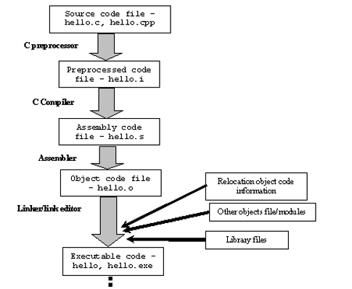
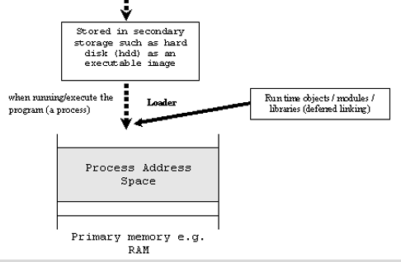
Language Processing System – Structure
Skeletal source program
Pre processor
source program
Compiler
Target assembly program
Assembler
Relocatable machine code
Linker / Loader
Absolute machine code

Slide 20
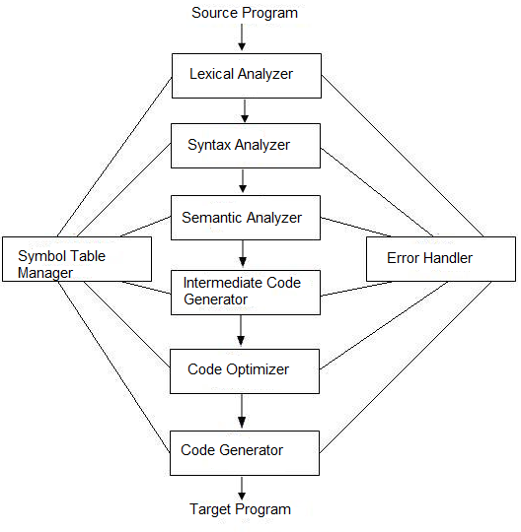
Structure of Compiler

Slide 21

Analysis Part:
Breaks up the source code into pieces and imposes a grammatical structure.
Uses this structure to create an intermediate representation of the source code.
Checks for syntax/semantics and provides messages to user in case of errors.
Builds a symbol table to collect and store information about source code.
It is also termed as front end of compiler
.

Slide 22

Synthesis part:
Synthesis part takes the intermediate representation as input and transforms it to the target program.
It is also termed as back end of compiler.

Slide 23
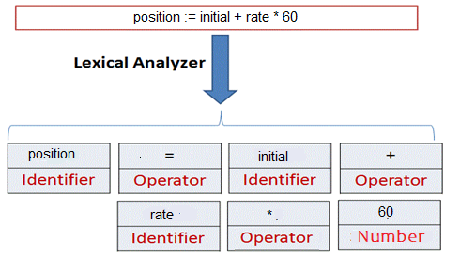
Lexical Analysis or Scanner
Reads characters in the source code and groups them into meaningful word called Token.
Tokens fall into these categories: Keywords, Operators, Identifiers,Constants,Literals strings and Punctuation.
Pattern: Rule for a set of string in the input for which a token is produced as output.
A Lexeme is a sequence of characters in the source code that is matched by the Pattern for a Token.
Input: stream of characters
Output: Token

Slide 24
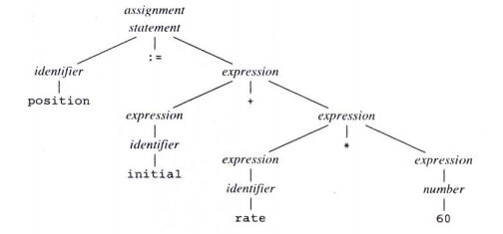
Syntax Analysis or Parser
Parser groups the tokens produced by lexical analyzer into grammatical phrases or syntactic variables.
Generates a tree like representation called parse tree .
A parse tree describes the syntactic structure of the input.
Parse tree for position :=initial + rate * 60

Slide 25
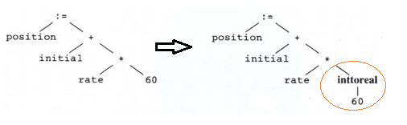
Semantic Analysis
Checks for semantic errors .
Concentrates on Type checking -whether operands are type compatible.
e.g. real number used to index an array.
Semantic analysis inserts a conversion of integer to real

Slide 26
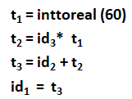
Intermediate Code Generation
Produces intermediate representations for the source program which are of the following forms:
Postfix notation
Three address code
Syntax tree
Commonly used form is the three address code.
where t₁ , t₂ , t₃ are compiler generated temporary variables.
Properties of intermediate code
It should be easy to produce and easy to translate into target program.

Slide 27
Code Optimizer
• Improves and produces optimized intermediate code as output.
e.g.
t₁ = id₃* 60.0
id₁ = id₂ + t₁
Helps in generating fast running machine code.
Techniques used:
Common sub expression elimination
Dead code elimination
Constant folding
Copy propagation
Code motion
Reduction in strength
Induction variable elimination......etc.

Slide 28
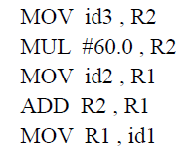
Code Generation
Intermediate instructions are translated into a sequence of machine instructions that perform the same task.
Using registers R1 and R2 the translation of the e.g. is:

Slide 29

Symbol Table Management
Stores all the information about identifiers used in the program.
Data structure containing a record for each identifier, with fields for the attributes of the identifier.
Whenever an identifier is detected in any of the phases, it is stored in the symbol table.

Slide 30
Error Handling
Each phase can encounter errors. After detecting an error, a phase must handle the error so that compilation can proceed.
Few errors:
In lexical analysis: misspelled name of some identifier.
In syntax analysis: missing semicolon or unbalanced parenthesis.
In Semantic analysis: Type mismatch.
In code optimization, errors occur when the result is affected by the optimization.
In code generation, it shows error when code is missing etc.

Slide 31
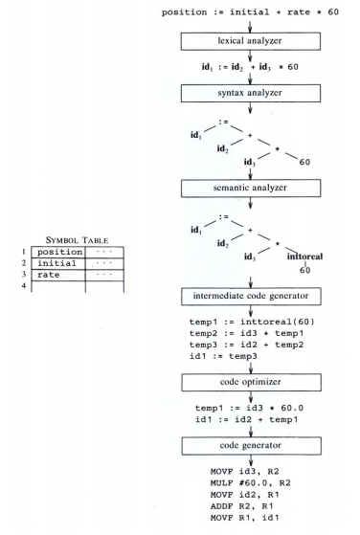
Translation of a statement

Slide 32
References
Alfred V. Aho, Jeffery D. Ullman & Ravi Sethi, ” Compiler Principles, Techniques & Tools”, Addison- Wesley Publishing Company,1986.
Alfred V. Aho, Jeffery D. Ullman, “Principles of Compiler Design”, Narosa Publishing House, 15th reprint, 1996.
D M. Dhamdhere , “System Programming”, 2nd Edition, Tata McGraw Hill Publishing, 1999.

Slide 33
THANK YOU

